Slide 1
Time Synchronization II Rate-based Synchronous Diffusion
Balz Aschwanden
Raoul Grossenbacher
David Bösiger
Jovana Micic

Slide 2
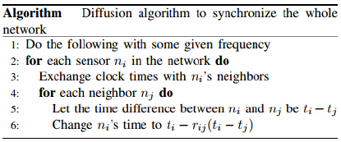
Algorithm

Slide 3
Code
Two Phases:
Neighborhood Discovery Phase
Broadcast
Convergence Phase
Unicast

Slide 4
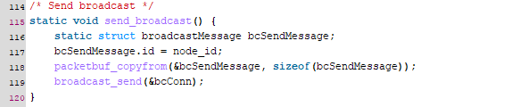
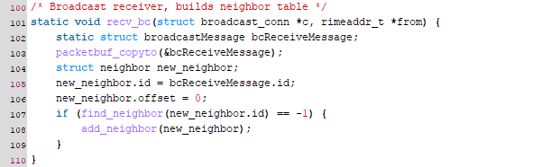
BroadCast

Slide 5
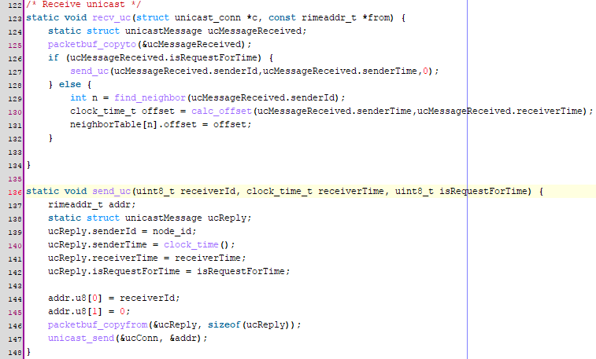
Unicast

